Slide 1
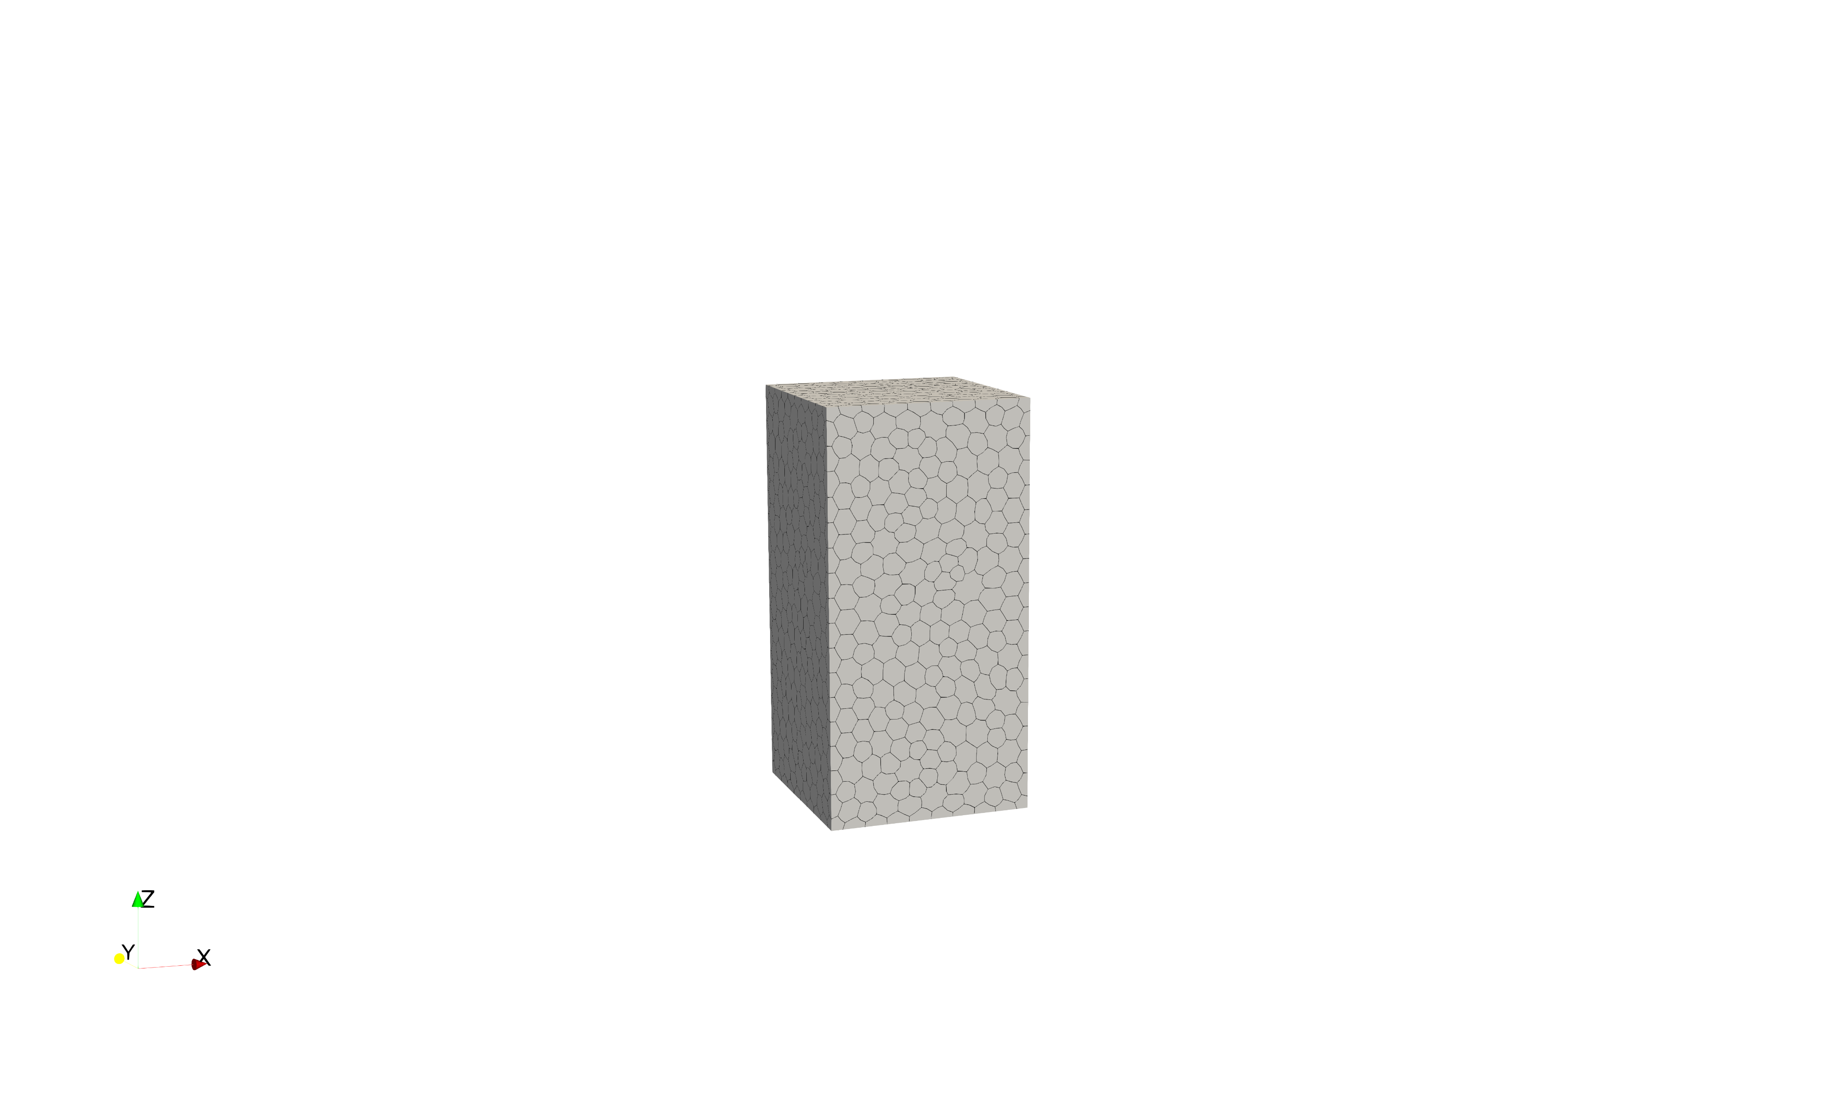
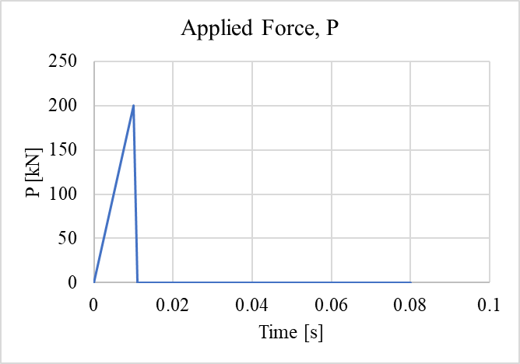
Free Vibration Test
Size in XYZ: 100mm x 100mm x 200mm
Same mesh as unconfined compression test
RP1 (50, 50, 200):
(Central nodes at top)
dx = u (Applied Force); dy = 0; dz = 0;
rx = 0; ry = 0; rz = 0
RP2 (50, 50, 0):
(Central nodes at bottom)
dx = 0; dy = 0; dz = 0;
rx = 0; ry = 0; rz = 0
Boundary Condition:
Nodes on the top are free (z=200)
Tie RP2 -> nodes on the bottom (z=0)
dx, dy, dz, rx, ry, rz are the same
RP1
P
0.011
0.01
Z
RP2
Y
X

Slide 2
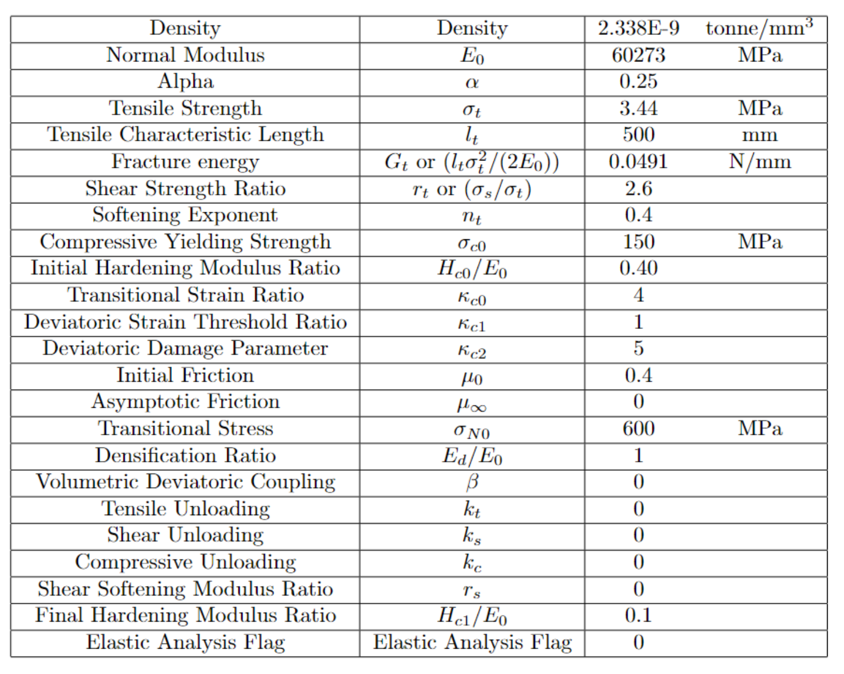
Material Property
Same as TPB test

Slide 3
Selected nodes:
(The node index start from 1)
node0_890 (50 50 0)
node1_1405 (54.4809 48.6083 20.97)
node2_ 1107 (52.1469 45.7597 40.2412)
node3_ 2126 (48.588 51.7969 60.8753)
node4_ 2128 (44.0282 56.7126 79.6343)
node5_ 2183 (57.7684 50.4392 100.096)
node6_ 2118 (46.7897 32.1821 119.21)
node7_ 2439 (45.8158 56.241 140.666)
node8_ 1721 (53.2392 62.5964 160.118)
node9_ 2289 (40.2156 42.9829 179.876)
node10_ 988 (50 50 200)
Node
RP1
P
10
9
8
7
6
5
4
3
2
1
RP2

Slide 4
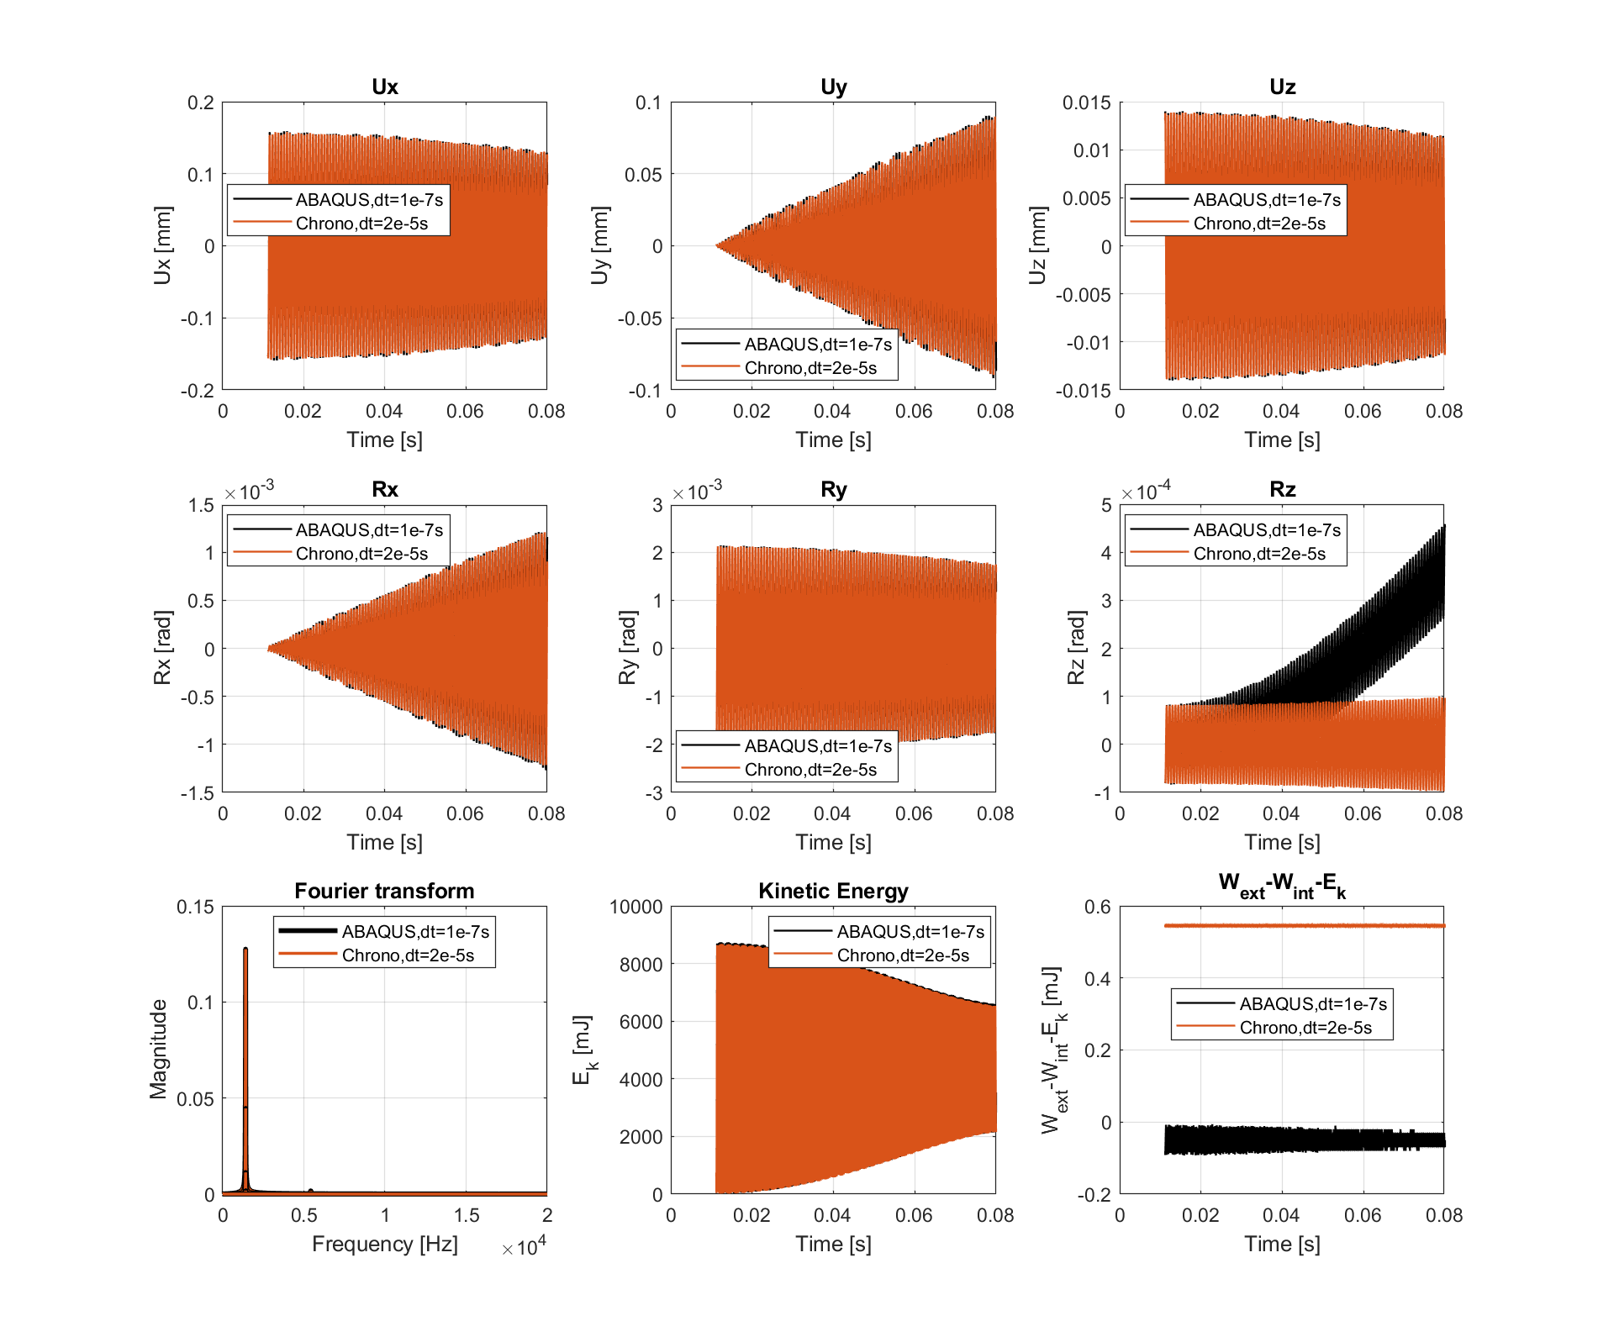
Results for node5
Node
RP1
P
10
9
8
7
6
5
4
3
2
1
RP2

Slide 5
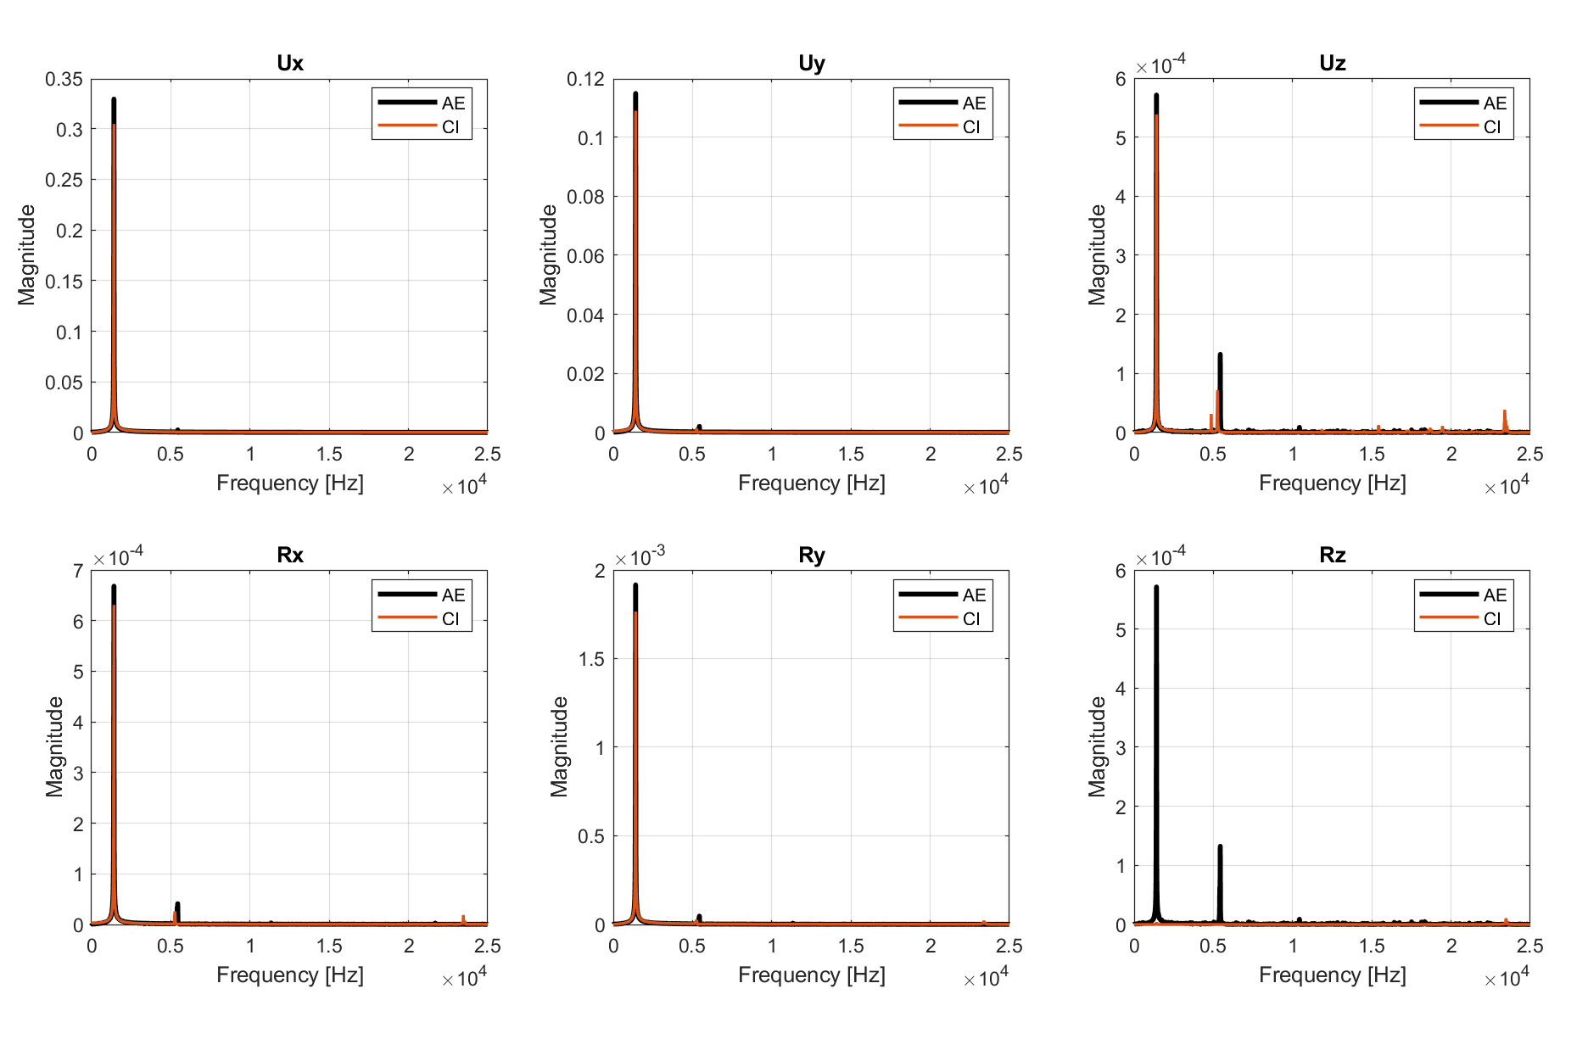
Results for node9

Slide 6
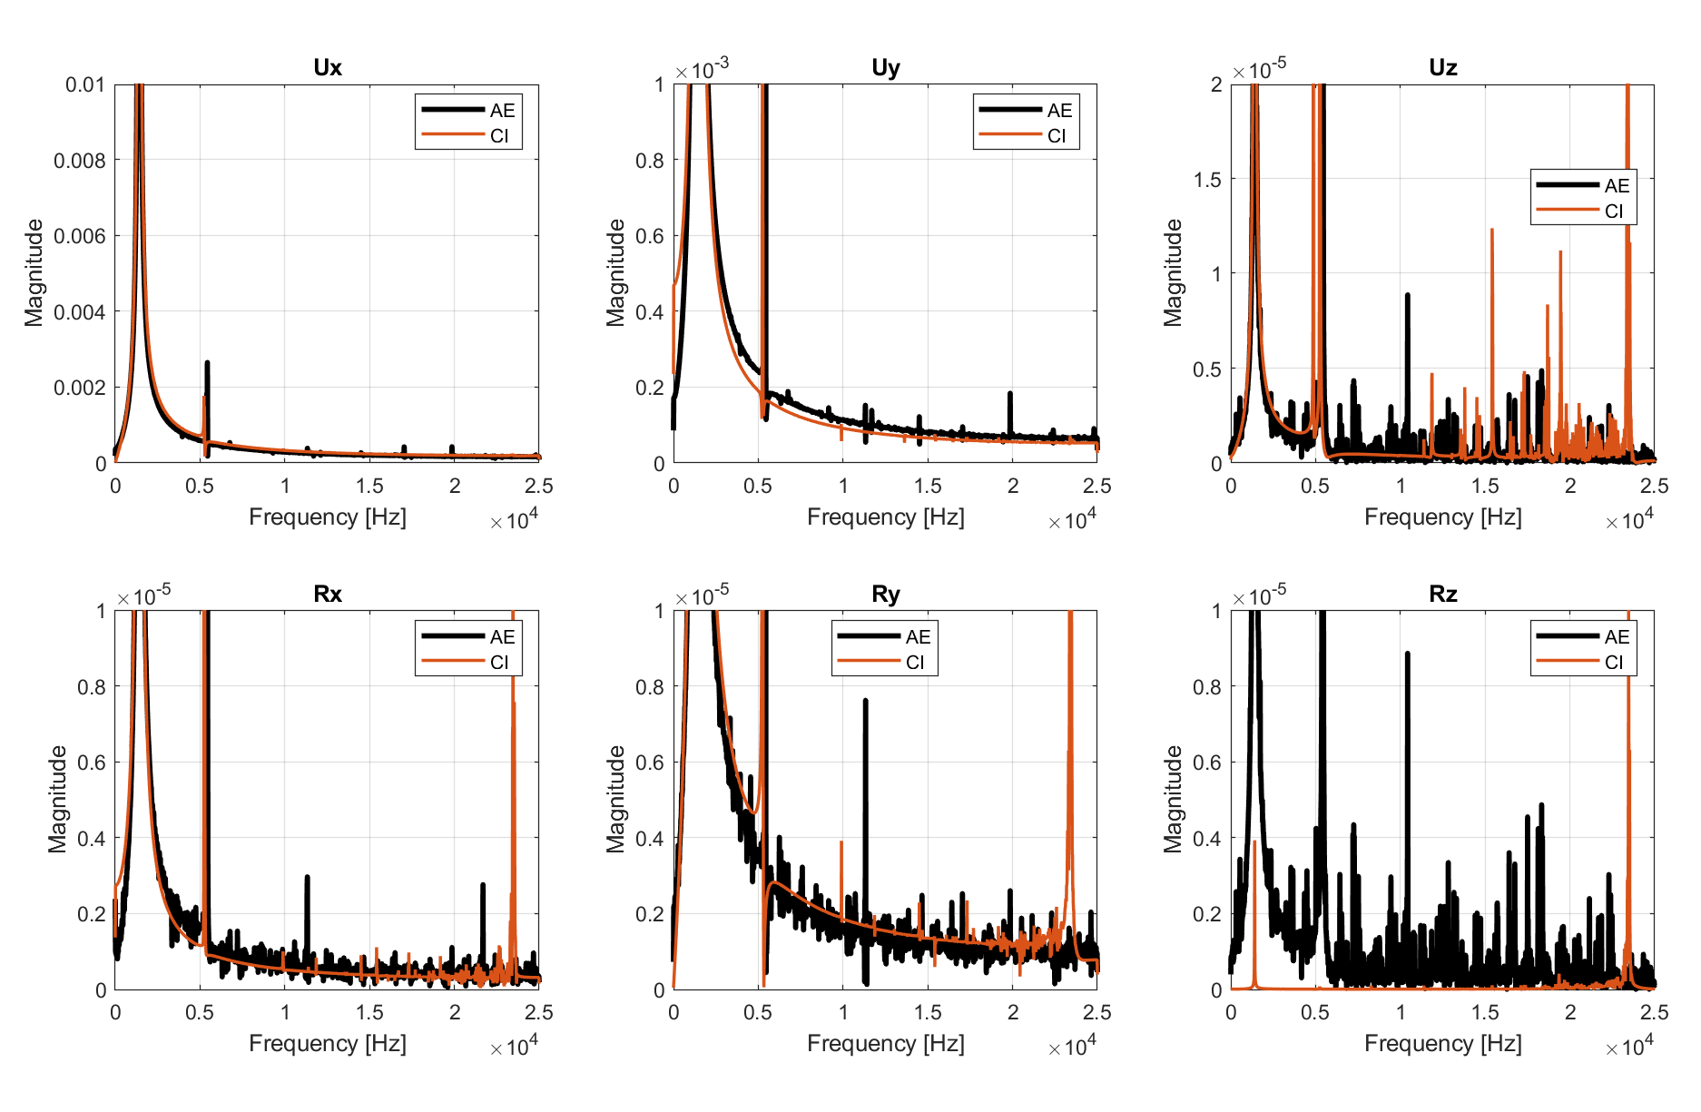
Results for node9

Slide 7
P
H
Z
D
Y
X
B

